Slide 1
Final Project
Nicolas Gonzalez
CIS 530
1

Slide 2
Research Question
Most common children’s names depending on two variables: Ethnicity and Gender.

Slide 3
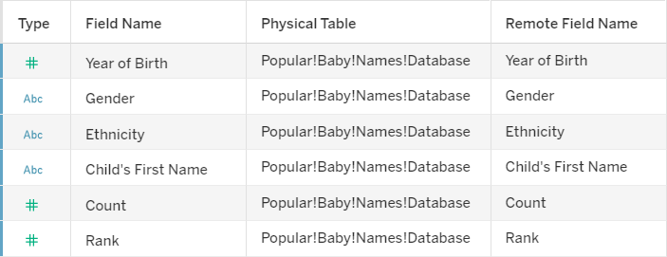
DATA SET
Popular Baby Names
CHALLENGE
I had to clean the data in the Ethnicity Field because they were errors in the types of ethnic groups.

Slide 4
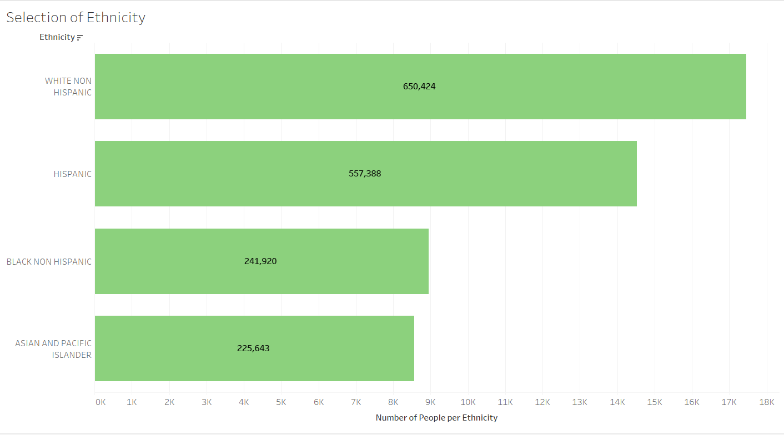
Results 1st worksheet
Selection of Ethnicity First Worksheet

Slide 5
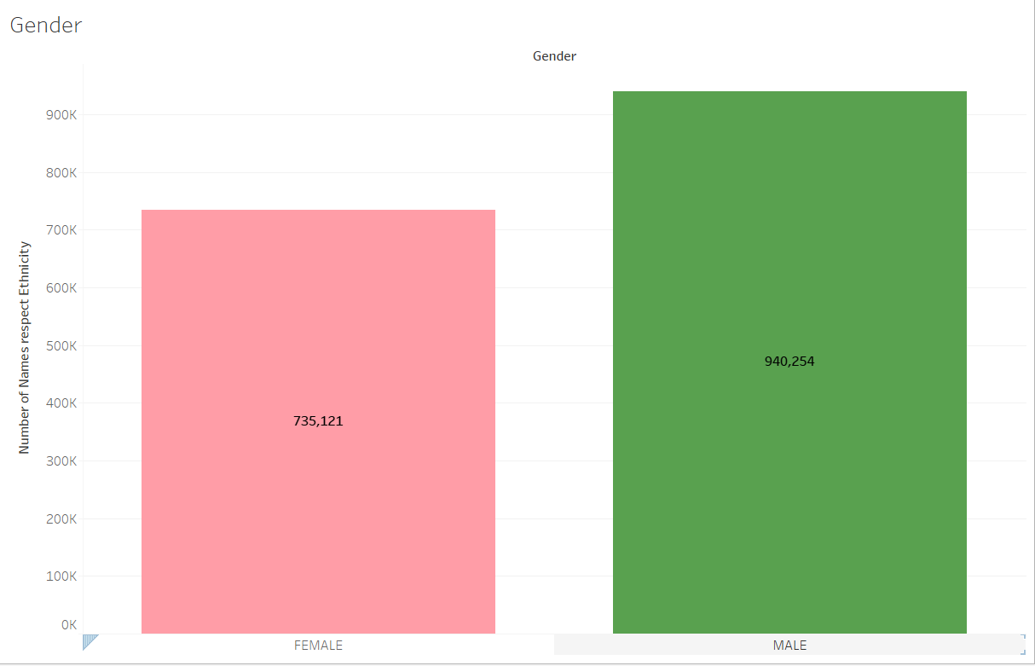
Results 2nd worksheet
Gender Worksheet

Slide 6
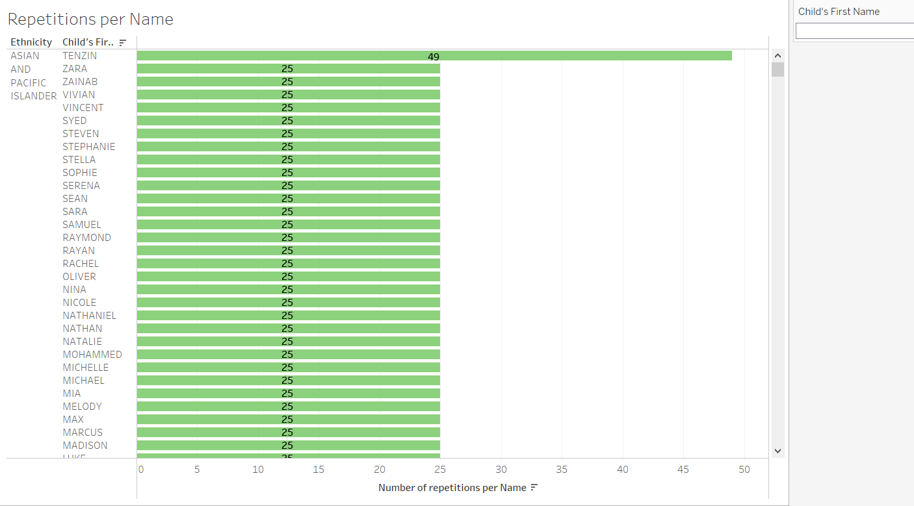
Results Third Worksheet
Repetitions per Name Third Worksheet

Slide 7
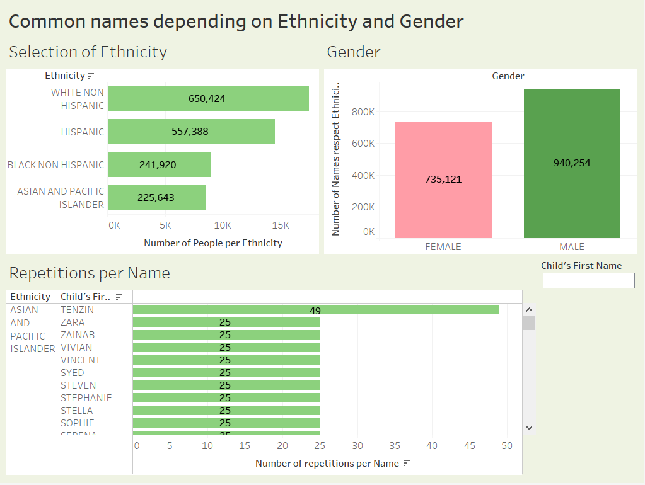
Results Dashboard
Common names depending on Ethnicity and Gender
Actions

Slide 8
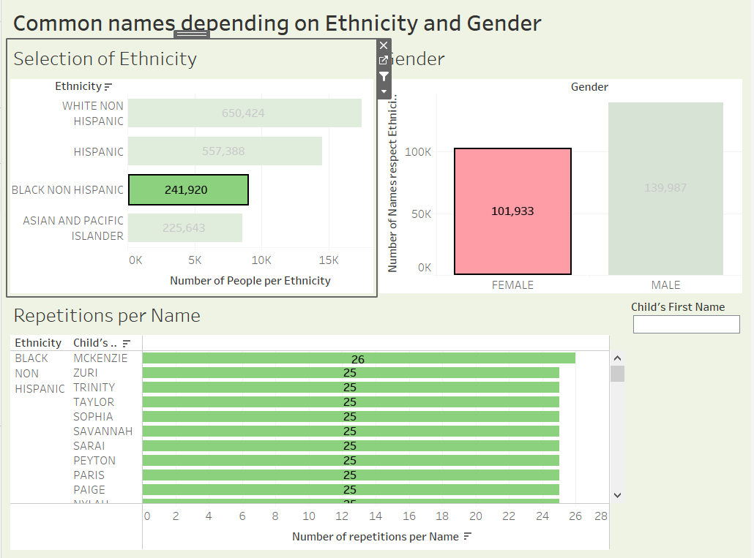
Dashboard
Popular Baby Names
Example
Ethnicity: Black non-Hispanic.
Gender: Female

Slide 9
Answer to research question
WHITE NON-HISPANIC: Male: Zev Female: Zissy
HISPANIC: Male: Zachary Female: Ximena
BLACK NON-HISPANIC: Male: Zion Female: Mckenzie
ASIAN AND PACIFIC ISLANDER: Male: Vicent Female: Zara

Slide 10
Thank you for your attention

